Slide 1

21MAT212 MATHEMATICS FOR INTELLIGENT SYSTEMS – 4
Dept of CEN, Amrita Vishwa Vidyapeetham, July - 2022
Under the supervision of Prof. (Dr.) Sowmya V
$ℓ_{1}$- Norm Problems using ADMM

Slide 2
Team 7
B.E.Pranav Kumaar CB.EN.U4AIE20052
Divi Eswar Chowdary CB.EN.U4AIE20012
Harsha Dabbara CB.EN.U4AIE20010
Rishekesan CB.EN.U4AIE20058

Slide 3


Abstract
With this project, we hope to get a fundamental grasp of how to solve L-1 norm optimization issues utilizing the Alternating direction method of multipliers (ADMM) Method, including the Least Absolute Deviation (LAD), Huber Fitting, and Least Absolute Shrinkage and Selection Operator (LASSO).

Slide 4
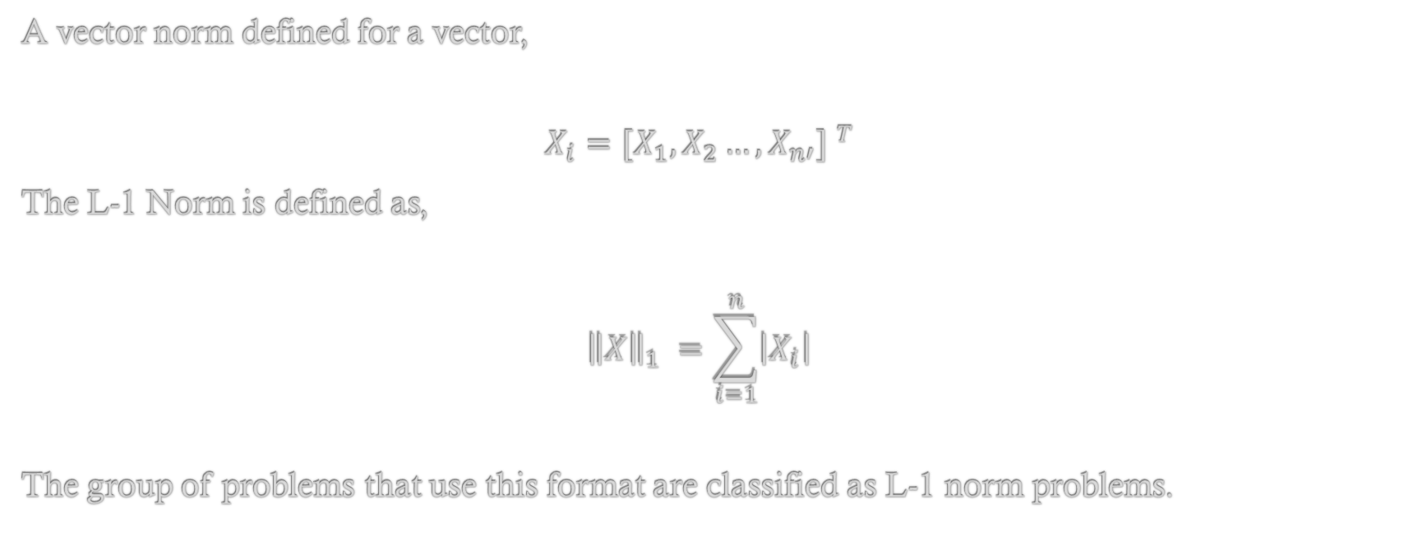
Introduction
A vector norm defined for a vector,
$$X_{i}={{[X}_{1},X_{2}…,X_{n′}] }^{T}$$
The L-1 Norm is defined as,
$${\left\|X\right\|}_{1} =\sum_{i=1}^{n}{\left|X_{i}\right|}$$
The group of problems that use this format are classified as L-1 norm problems.

Slide 5
Precursors
Dual Ascent
Dual Decomposition
Augmented Lagrangian and Method of Multipliers
Alternating direction method of multipliers

Slide 6


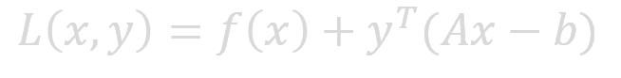

Dual Ascent
Let us consider the following Convex Constrained Optimization problem:
$$\min_{x∈R^{n}}{f\left(x\right)}$$
$$such that Ax=b$$
Here $A∈R^{mxn} , b∈R^{m} and f :R^{n} →R$is a convex function y is a Lagrangian Multiplier.
$$L\left(x,y\right)=f\left(x\right)+y^{T}(Ax−b)$$
We can dual function for the above function as,
$$g\left(y\right)=\inf_{x∈R^{n}}{L\left(x,y\right)=−f^{∗}\left(−A^{T}y\right)−b^{T}y}$$
Here $f^{∗}$ is a convex conjugate of f.

Slide 7

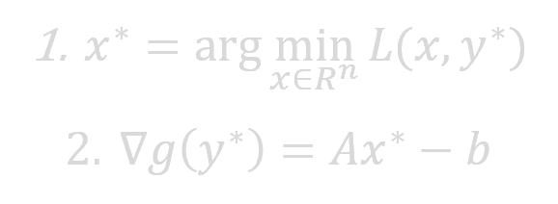

Now we have to optimize the dual function,
$$\max_{y∈R^{n}}{g\left(y\right)}$$
Consider the strong duality holds for the above. The primal and dual solution are same with this primal solutions $x^{∗}$can be recovered from dual optimal solution $y^{∗}.$
$$x^{∗}=\arg{\min_{x∈R^{n}}{L(x,y^{∗})}}$$
Now, Coming to Dual Ascent Method ,we use gradient ascent method to find out the residual for the equality constraint Updating of Variables can be done in following way
$x^{∗}=\arg{\min_{x∈R^{n}}{L(x,y^{∗})}}$
$∇g\left(y^{∗}\right)=Ax^{∗}−b$

Slide 8

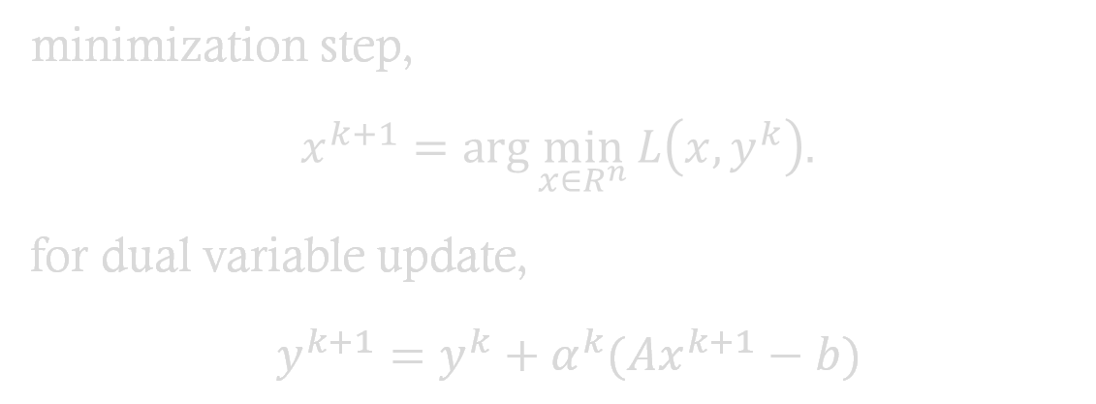
Now the iterative updates are,
minimization step,
$x^{k+1}=\arg{\min_{x∈R^{n}}{L\left(x,y^{k}\right). }}$
for dual variable update,
$y^{k+1}=y^{k}+α^{k}(Ax^{k+1}−b)$
Where $α^{k}$ is step – size.

Slide 9

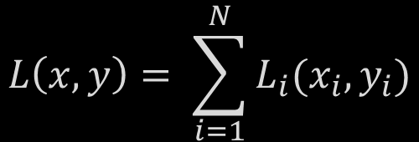
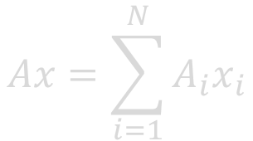
Dual Decomposition
The major benefit of the dual ascent method is that it can lead to a decentralized algorithm. Suppose objective $f$ is separable, let’s breakdown the objective function $f$(x) as,
$$f\left(x\right)= \sum_{i=1}^{N}{f_{i}(x_{i})}$$
Where $x=[x1,x2,···,xN]$and each $x_{i}∈R^{n}$ $i$ is a sub-vector of x. Similarly, partitioning A=[A₁,A₂,···,A_{N}], we get
$$Ax=\sum_{i=1}^{N}{A_{i}x_{i}}$$
$$L\left(x,y\right)= \sum_{i=1}^{N}{L_{i}(x_{i},y_{i})}$$

Slide 10
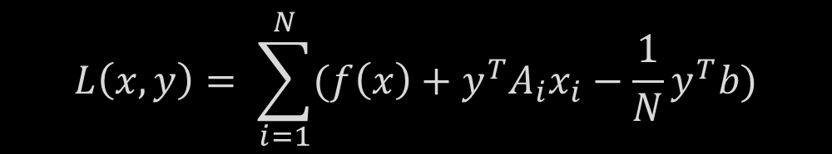
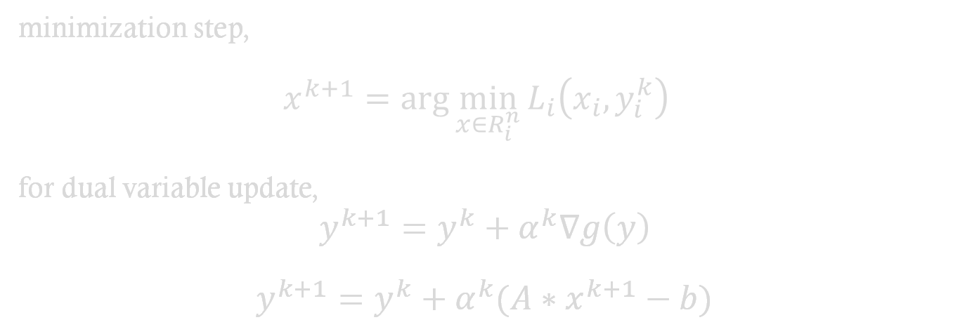
$$L\left(x,y\right)= \sum_{i=1}^{N}{(f\left(x\right)+y^{T}A_{i}x_{i}−\frac{1}{N}y^{T}b)}$$
minimization step,
$$x^{k+1}=\arg{\min_{x∈R_{i}^{n}}{L_{i}\left(x_{i},y_{i}^{k}\right) }}$$
for dual variable update,
$y^{k+1}=y^{k}+α^{k}∇g\left(y\right)$
$y^{k+1}=y^{k}+α^{k}(A∗x^{k+1}−b)$
$$∇g\left(y^{∗}\right)=Ax^{∗}−b$$
The minimization step is Solved Parallelly. Consequently, this decomposition in the dual ascent method is referred as the dual decomposition.

Slide 11

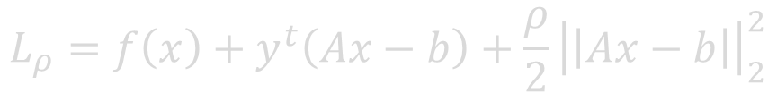

Augmented Lagrangian and Method of Multipliers
This Method is to Robust Dual Ascent,
$$L_{ρ}=f\left(x\right)+y^{t}\left(Ax−b\right)+\frac{ρ}{2}{\left|\left|Ax−b\right|\right|}_{2}^{2}$$
Here ρ > 0 is called the penalty parameter.
$$\min_{x∈R^{n}}{f(x)}+\frac{ρ}{2}{\left|\left|Ax−b\right|\right|}_{2}^{2}$$
$$such that Ax=b$$
This augmented Lagrangian can be viewed as the unaugment Lagrangian type of the problem.

Slide 12
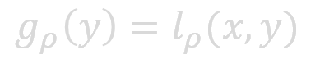
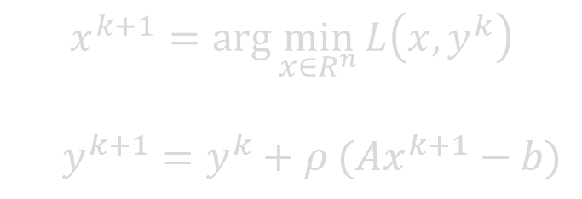
The Both Equation are Same, because for any feasible $x$, the term $\frac{ρ}{2}{\left|\left|Ax−b\right|\right|}_{2}^{2}$ becomes zero.
The associated dual is
$$g_{ρ}\left(y\right)=l_{ρ}(x,y)$$
Adding $\frac{ρ}{2}{\left|\left|Ax−b\right|\right|}_{2}^{2}$ to f (x) makes $g_{ρ}\left(y\right)$ differentiable under milder conditions than on the original problem.
$$x^{k+1}=\arg{\min_{x∈R^{n}}{L\left(x,y^{k}\right) }}$$ $y^{k+1}=y^{k}+ρ (Ax^{k+1}−b)$
It Converges Far Better than Dual Ascent

Slide 13
ADMM ALTERNATING DIRECTION METHOD OF MULTIPLIERS

Slide 14
Many Problems in Machine learning can be framed as a convex optimization . Due to large size of Data, we need a paradigm by which could distribute the task .Decentralize the workflow, There comes the ADMM which could used as an Optimization Algorithm for decentralized flow.
ADMM is Combined Method which taken Best Properties of Method of multipliers and Decomposability of Dual Ascent

Slide 15
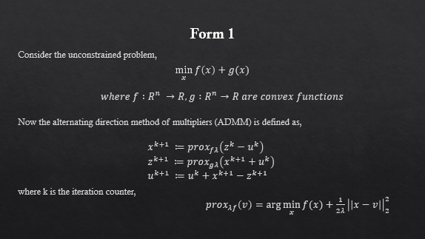
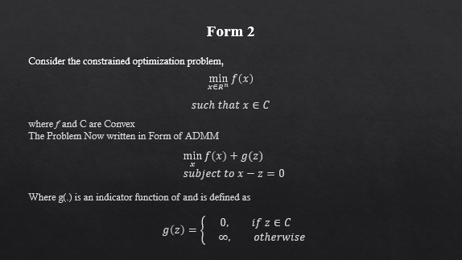
ADMM solves the problems in particular form and adheres two forms
Form 1
Form 2

Slide 16
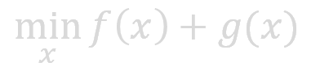

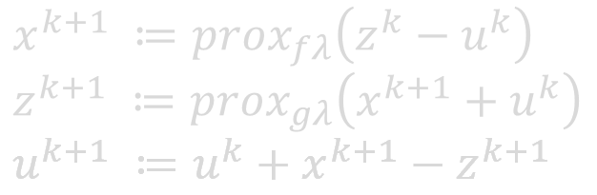
Form 1
Consider the unconstrained problem,
$$\min_{x}{f\left(x\right)+g(x)}$$
$$where f :R^{n} →R,g :R^{n}→R are convex functions$$
Now the alternating direction method of multipliers (ADMM) is defined as,
$$x^{k+1} ≔prox_{fλ}\left(z^{k}−u^{k}\right) \\ z^{k+1} ≔prox_{gλ}\left(x^{k+1}+u^{k}\right) \\ u^{k+1} ≔u^{k}+x^{k+1}−z^{k+1}$$
where k is the iteration counter,
$prox_{λf}\left(v\right)=\arg{\min_{x}{f(x)}+\frac{1}{2λ}{\left|\left|x−v\right|\right|}_{2}^{2}}$

Slide 17

Derivation For Form 1
x
x
-
z
= 0
Now our Optimization Problem changed to
$$\min{f\left(x\right)+g\left(z\right)}$$
$$such that x−z=0$$
And this is Equivalent to minimizing $f\left(x\right)+g\left(x\right)$
Now, Lagrangian equation
$$L_{ρ}\left(x,y,z\right)=f\left(x\right)+g\left(z\right)+y^{T}\left(x−z\right)+\left(\frac{ρ}{2}\right){\left|\left|x−z\right|\right|}_{2}^{2}$$
Where ρ >0 is a parameter and y ∈ Rn is the Lagrangian dual variable

Slide 18
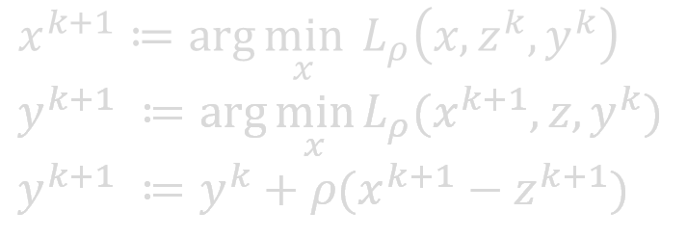
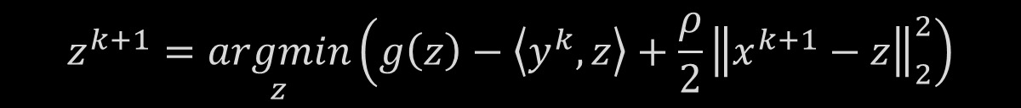

$$L_{ρ}\left(x,y,z\right)=f\left(x\right)+g\left(z\right)+y^{T}\left(x−z\right)+\left(\frac{ρ}{2}\right){\left|\left|x−z\right|\right|}_{2}^{2}$$
$$L_{ρ}\left(x,y,z\right)=f\left(x\right)+g\left(z\right)+\left\langle y^{T},x\right\rangle −\left\langle y^{T},z\right\rangle +\left(\frac{ρ}{2}\right){\left|\left|x−z\right|\right|}_{2}^{2}$$
$$x^{k+1}=\underset{x}{argmin}\left(f\left(x\right)+\left\langle y^{k},x\right\rangle +\frac{ρ}{2}{\left\|x−z^{k}\right\|}_{2}^{2}\right)$$
$$z^{k+1}=\underset{z}{argmin}\left(g\left(z\right)−\left\langle y^{k},z\right\rangle +\frac{ρ}{2}{\left\|x^{k+1}−z\right\|}_{2}^{2}\right)$$
$$y^{k+1}:=y^{k}+ρ\left(x^{k+1}−z^{k+1}\right)$$
$$x^{k+1}≔\arg{\min_{x}{L_{ρ}\left(x,z^{k},y^{k}\right)}} \\ y^{k+1} ≔\arg{\min_{x}{L_{ρ}(x^{k+1},z,y^{k}}}) \\ y^{k+1} ≔y^{k}+ρ(x^{k+1}−z^{k+1})$$

Slide 19




$$x^{k+1}=\underset{x}{argmin}\left(f\left(x\right)+\left\langle y^{k},x\right\rangle +\frac{ρ}{2}{\left\|x−z^{k}\right\|}_{2}^{2}\right)$$
$$z^{k+1}=\underset{z}{argmin}\left(g\left(z\right)−\left\langle y^{k},z\right\rangle +\frac{ρ}{2}{\left\|x^{k+1}−z\right\|}_{2}^{2}\right)$$
$$y^{k+1}:=y^{k}+ρ\left(x^{k+1}−z^{k+1}\right)$$
By completing Squares Method, we are Converting Equation to Quadratic Form
$$x^{k+1}=\underset{x}{argmin}\left(f\left(x\right)+\frac{ρ}{2}{\left\|x−z^{k}+\frac{1}{ρ}y^{k}\right\|}_{2}^{2}\right)$$
$$z^{k+1}=\underset{z}{argmin}\left(g\left(z\right)+\frac{ρ}{2}{\left\|x^{k+1}−z+\frac{1}{ρ}y^{k}\right\|}_{2}^{2}\right)$$
$$y^{k+1}:=y^{k}+ρ\left(x^{k+1}−z^{k+1}\right)$$

Slide 20



Now Let us make some assumptions that we will use those for make it to proximal Form
$$x^{k+1}=\arg{\min_{x}{f\left(x\right)}+{\left|\left|x−z^{k}+u^{k}\right|\right|}_{2}^{2}} \\ z^{k+1}=\arg{\min_{z}{g\left(z\right)}+{\left|\left|x^{k+1}−z+u^{k}\right|\right|}_{2}^{2}} \\ y^{k+1}=y^{k}+ρ(x^{k+1}−z^{k+1})$$
$$u^{k}=\frac{1}{ρ}y^{k},λ=\frac{1}{ρ}$$
$$x^{k+1}=\arg{\min_{x}{f\left(x\right)}+{\left|\left|x−{(z}^{k}+u^{k})\right|\right|}_{2}^{2}} \\ z^{k+1}=\arg{\min_{z}{g\left(z\right)}+{\left|\left|{z−(x}^{k+1}+u^{k})\right|\right|}_{2}^{2}} \\ y^{k+1}=y^{k}+ρ(x^{k+1}−z^{k+1})$$

Slide 21


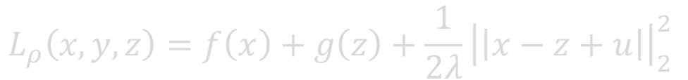
Now as we know about proximal function
$prox_{λf}\left(v\right)=\arg{\min_{x}{f(x)}+\frac{1}{2∗λ}{\left|\left|x−v\right|\right|}_{2}^{2}}$
Now Let us Write Everything into proximal Form
$$x^{k+1}=prox_{λf}(z^{k}−u^{k}) \\ z^{k+1}=prox_{λg}\left(x^{k+1}+u^{k}\right) \\ u^{k+1}≔u^{k}+x^{k+1}−z^{k+1}$$
Our New Equation is below
$$L_{ρ}\left(x,y,z\right)=f\left(x\right)+g\left(z\right)+\frac{1}{2λ}{\left|\left|x−z+u\right|\right|}_{2}^{2}$$
which is converted form This below Equation
$$L_{ρ}\left(x,y,z\right)=f\left(x\right)+g\left(z\right)+y^{T}\left(x−z\right)+(\frac{ρ}{2}){\left|\left|x−z\right|\right|}_{2}^{2}$$

Slide 22
ADMM solves the problems in particular form and adheres two forms
Form 1
Form 2

Slide 23


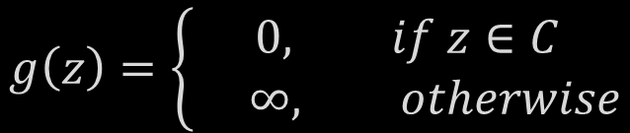
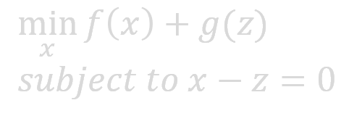
Form 2
Consider the constrained optimization problem,
$$\min_{x∈R^{n}}{f\left(x\right)}$$
$$such that x∈C$$
where f and C are Convex The Problem Now written in Form of ADMM
$$\min_{x}{f\left(x\right)+g(z) } \\ subject to x−z=0$$
Where g(.) is an indicator function of and is defined as
$$g\left(z\right)=\left\{\begin{aligned}0, if z∈C \\ ∞, otherwise\end{aligned}\right.$$

Slide 24
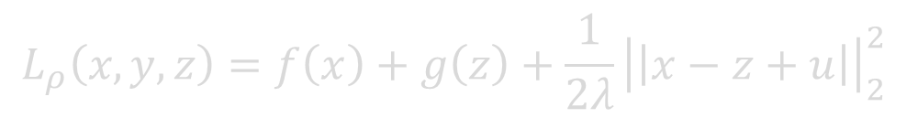

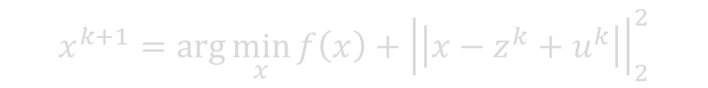

In the Above Equation all our constraints are represent into an indicator function $g(z)$ in a different variable and the variables made equal with introducing a new constraint.
Now Lets us Consider the augmented Lagrangian function
$$L_{ρ}\left(x,y,z\right)=f\left(x\right)+g\left(z\right)+\frac{1}{2λ}{\left|\left|x−z+u\right|\right|}_{2}^{2}$$
$$x^{k+1}=\arg{\min_{x}{f\left(x\right)}+{\left|\left|x−z^{k}+u^{k}\right|\right|}_{2}^{2}}$$
To Obtain $z$ ,we Project the ($x^{k+1}+ u^{k}$ ) onto C
$$z^{k+1}=\prod_{C}{(x^{k+1}}+u^{k}) \\ u^{k+1} ≔u^{k}+x^{k+1}−z^{k+1}$$

Slide 25




Slide 26
LAD Least Absolute Deviation

Slide 27

What is Least Absolute Deviation ?
Least Absolute Deviations (LAD) is an alternative to traditional Least Squares by using cost function. It is basically minimizing the sum of the absolute differences between the target value (Y_{i}) and the estimated values (f(x_{i})):
Defined as :
$$S=\sum_{i=1}^{m}{\left|y_{i}−f(x_{i})\right|}$$

Slide 28

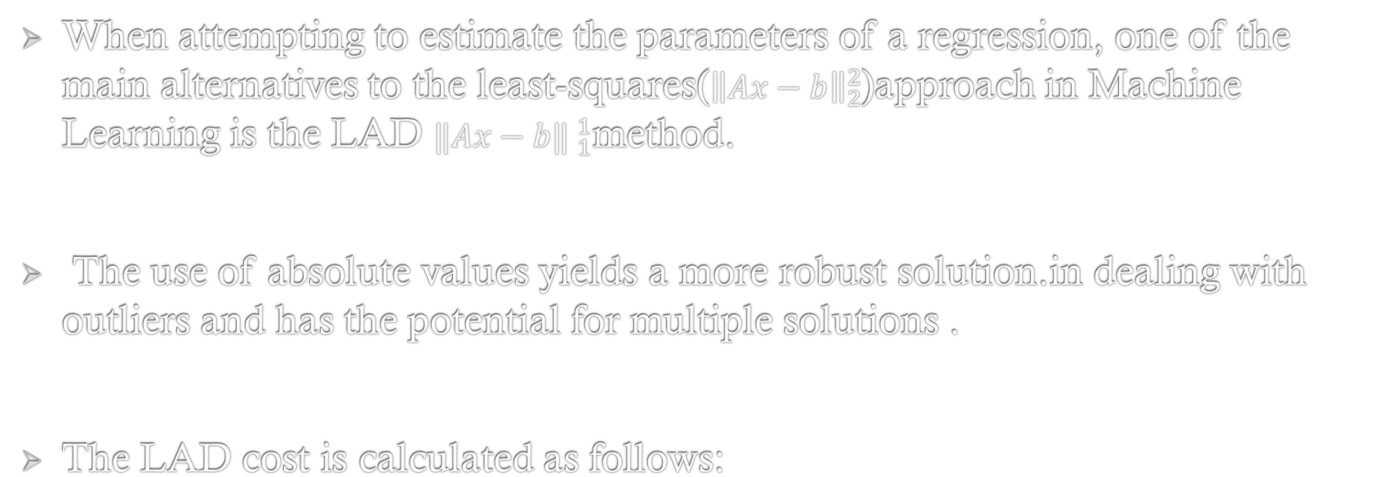
Machine learning context
When attempting to estimate the parameters of a regression, one of the main alternatives to the least-squares(${\left\|Ax−b\right\|}_{2}^{2}$)approach in Machine Learning is the LAD ${‖Ax−b‖ }_{1}^{1}$method.
The use of absolute values yields a more robust solution.in dealing with outliers and has the potential for multiple solutions .
The LAD cost is calculated as follows:
$$S=\sum_{i=1}^{m}{\left|y_{i}−f(x_{i})\right|}$$

Slide 29
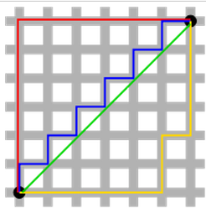
Least square(L2-norm) vs Least absolute deviation (L1-norm)
Built-in feature selection
Sparsity
Computational efficiency.
L2 loss Function | L1 Loss Function
Not very robust | Robust
Stable solution | Stable Solution
Always One Solution | Possibly Multiple Solution

Slide 30
ADMM Formulation
In ADMM form, the problem can be written as
$$\min{ }{\left\|z\right\|}_{1} \text{subject} \text{to} Ax−b=z$$
Since we are updating one variable at a time, the following form will produce same result.
Now , augmented lagrangian function is :
$L(.)={\left\|z\right\|}_{1}+y^{T}(Ax−b−z)+\frac{ρ}{2}{\left\|Ax−b−z\right\|}_{2}^{2}$
$$L\left(.\right)={\left\|z\right\|}_{1}+\frac{ρ}{2}{\left\|Ax−b−z+y/ρ\right\|}_{2}^{2}={\left\|z\right\|}_{1}+\frac{ρ}{2}{\left\|Ax−b−z+u\right\|}_{2}^{2}$$

Slide 31
Now divide leave the constant part and differentiate the above lagrangian function w.r.t x.
$$x^{k+1}=\arg{\min_{x}}L_{ρ}(x,z^{k},u^{k)}=\arg{\min_{x}}\frac{1}{2}{\left|Ax−b−z^{k}+u^{k}\right|}_{2}^{2}$$
$$\frac{∂L_{ρ}\left(x , z^{k} , u^{k}\right)}{∂x}=A^{T}\left(Ax−b−z^{k}+u^{k}\right)=0⇒x^{k+1}={\left(A^{T}A\right)}^{−1}A^{T}\left(b+z^{k}−u^{k}\right)$$
$$x^{k+1}={\left(A^{T}A\right)}^{−1}A^{T}\left(b+z^{k}−u^{k}\right)$$

Slide 32
Update of z in the k+1 th iteration
$$z^{k+1}=\arg{\min_{x}}L_{ρ}\left(x^{k+1} , z^{k} , u^{k}\right)=\arg{\min_{z}} {\left\|z\right\|}_{1}+\frac{ρ}{2}{\left\|Ax^{k+1}−b−z+u^{k}\right\|}_{2}^{2}$$
$\min_{x}{\left\|x\right\|}_{1}+\frac{1}{2λ}{\left\|x−v\right\|}_{2}^{2}$=$S_{λ}$(v)$≡shrinking each element of vector v towards 0 byλ$
$$z^{k+1}=\arg{\min_{z}} {\left\|z\right\|}_{1}+\frac{1}{2\left(1/ρ\right)}{\left\|z−\left(Ax^{k+1}−b+u^{k}\right)\right\|}_{2}^{2}=S_{\left(1/ρ\right)}\left(Ax^{k+1}−b+u^{k}\right)$$

Slide 33
The final Equation of z,
$$z^{k+1}=S_{\left(1/ρ\right)}\left(Ax^{k+1}−b+u^{k}\right)$$
Finally scaled Lagrangian update is given by,
$$u^{k+1}=u^{k}+(Ax^{k+1}−b−z^{k+1})$$

Slide 35
Huber Fitting

Slide 36

Huber Loss Function
The huber fitting problem is to fit the data with huber loss.
Formula for Huber Function :
$$L_{δ}= \left\{\begin{aligned}\frac{1}{2}a^{2} for \left|a\right|≤δ \\ δ\left(\left|a\right|−\frac{1}{2}δ\right), otherwise \end{aligned}\right.$$

Slide 37


Huber Loss Function :
Huber loss function is defined as,
$$g\left(z\right)= \sum_{i=1}^{m}{huber\left(z_{i}\right)}$$
$${\left|\left|z\right|\right|}_{h}= \left\{\begin{aligned}&\frac{z^{2}}{2},\left|z\right|≤1 \\ &\left|z\right|−\frac{1}{2}, \left|z\right|>1\end{aligned}\right.$$
Representing in ADMM format
$$\min_{x,z}{g\left(z\right) subject to Ax−z=b}$$

Slide 38

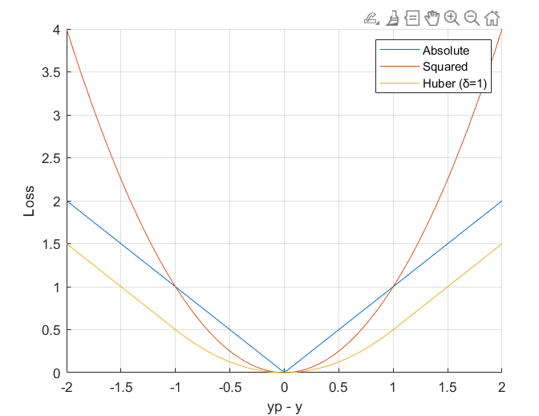
Loss comparisons between LAD, LS and Huber

Slide 39



Solution
$$Let x ε R^{n}$$
$$z_{mx1}=A_{mxn}x_{nx1}−b_{mx1}$$
$$z_{i}={\left(A_{mxn}x\right)}_{i}−b_{i};i=1,2,3,…,m$$
$$A is a matrix of size m x n. and b is a vector of dimension m x 1 .$$
$$\sum_{i=1}^{m}{huber\left(z_{i}\right) is minimum}$$
$$where \\ huber\left(z_{i}\right)=\frac{1}{2}z_{i}^{2} , \left|z_{i}\right|≤1 \\ huber\left(z_{i}\right)=\left|z_{i}\right|−\frac{1}{2} , \left|z_{i}\right|>1$$
Let us write the augmented lagrangian function for the above Huber problem,

Slide 40

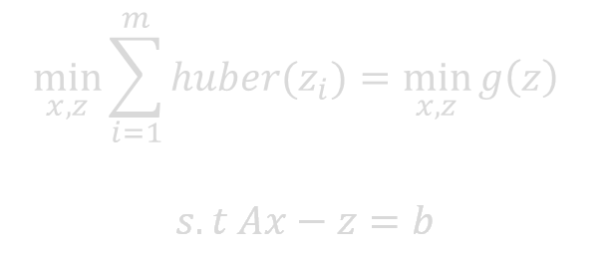


The optimization problem is
$$\min_{x,z}{\sum_{i=1}^{m}{huber(z_{i})}}=\min_{x,z}{g\left(z\right) }$$
$$s.t Ax−z=b$$
Let us write the augmented Lagrangian function for the above Huber problem.
$$L_{ρ}\left(x,y,z\right)=g\left(z\right)+y^{T}\left(Ax−b−z\right)+\frac{ρ}{2} \left({\left|\left|Ax−b−z\right|\right|}_{2}^{2}\right)$$
Let us assume $u=\frac{y}{ρ} and λ=1/ρ$
$$\min_{x,z}{g\left(z\right) subject to Ax−z=b}$$
$$L_{ρ}\left(x,u,z\right)=g\left(z\right)+\frac{1}{2λ}{\left|\left|Ax−b−z+u\right|\right|}_{2}^{2}$$

Slide 41



Update of x in k+1 th iteration
Consider minimization of augmented lagrangian function L w.r.t x and assume $y=y^{k} and u=u^{k}.$
Now , augmented lagrangian function is :
$L_{ρ}\left(x,u^{k},z^{k}\right)=g\left(z^{k}\right)+\frac{1}{2λ}{\left|\left|Ax−b−z^{k}+u^{k}\right|\right|}_{2}^{2}$
Now divide leave the constant part and differentiate the above lagrangian function w.r.t $x$.
$$⇒\frac{δL_{ρ}\left(x,z^{k},u^{k}\right)}{δx}=A^{T}\left(Ax−b−z^{k}+u^{k}\right)=0$$
$${⇒ A}^{T}Ax=A^{T}\left(b+z^{k}−u^{k}\right)$$
$$x^{k+1}={\left(A^{T}A\right)}^{−1}A^{T}\left(b+z^{k}−u^{k}\right)$$

Slide 42



Update of z in the k+1 th iteration
$$we update the values x=x^{k+1} and u=u^{k}. Now we rewrite \\ the Lagrangian Function.$$
$$L_{ρ}\left(x^{k+1},u^{k},z\right)=g\left(z\right)+\frac{1}{2λ}{\left|\left|Ax^{k+1}−b−z+u^{k}\right|\right|}_{2}^{2}$$
$$Note :g\left(z\right) consist of two piece wise continuous functions.$$
Now divide leave the constant part and differentiate the above lagrangian function $L_{ρ} w.r.t z$
$${\left|\left|z\right|\right|}_{h}= \left\{\begin{aligned}&\frac{z^{2}}{2},\left|z\right|≤1 …….. case(1) \\ &\left|z\right|−1, \left|z\right|>1 ….case(2)\end{aligned}\right.$$

Slide 43


Case - I
Let $g\left(z\right)=\frac{z^{2}}{2} ,then Now let us differentiate w.r.t z . and equate it to 0.$
$$⇒ \frac{δL_{ρ}\left(x^{k+1},z,u^{k}\right)}{δx}=z−\frac{1}{λ}\left(Ax^{k+1}−b−z+u^{k}\right)=0$$
$$⇒ \left(1+λ\right)z^{k+1}=\left(Ax^{k+1}−b−u^{k}\right)$$
$$z^{k+1}=\frac{1}{1+λ}\left(Ax^{k+1}−b+u^{k}\right)−−−−−−−\left(1\right)$$

Slide 44





Case – II
Let $g\left(z\right)=\left|z\right|−\frac{1}{2},then$
$$z^{k+1}=\arg{\min_{z}{|z|−\frac{1}{2}+\frac{1}{2λ} \left\|Ax^{k+1}−b−z+u^{k}\right\|}}$$
Proximal operator : Consider the proximal operator on a variable v with some constant α to be defined as,
${prox}_{f}\left(v\right)=\arg_{x}\min\left(f\left(x\right) + \frac{1}{2α}\left\|x−v\right\|{2 \atop 2} \right)≡ S_{α}(v)$ …. (IX.29)
$$⇒ (\frac{λ}{1+λ})\left(Ax^{k+1}−b+u^{k}\right)±λ$$
$$z^{k+1}={(\frac{λ}{1+λ})S}_{λ}\left(Ax^{k+1}−b+u^{k}\right)−−−−−\left(2\right)$$
$where S_{λ} represents shrinkage by ±λ sign .$

Slide 45
Finally we combine equations (1) and (2) to get
$$z^{k+1}=\frac{1}{1+λ}\left(Ax^{k+1}−b+u^{k}\right)+{(\frac{λ}{1+λ})S}_{λ}\left(Ax^{k+1}−b+u^{k}\right)$$
Update of u in k+1 iteration
The original lagrangian multiplier term is $u^{T}\left(Ax−b−z\right)$
$$u^{k+1}=u^{k}+( Ax^{k+1}−b−z^{k+1})$$

Slide 46
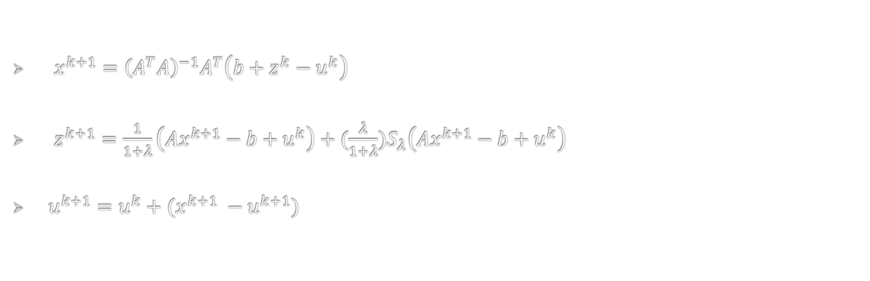
Final update equations,
$x^{k+1}={\left(A^{T}A\right)}^{−1}A^{T}\left(b+z^{k}−u^{k}\right)$
$z^{k+1}=\frac{1}{1+λ}\left(Ax^{k+1}−b+u^{k}\right)+{(\frac{λ}{1+λ})S}_{λ}\left(Ax^{k+1}−b+u^{k}\right)$
$u^{k+1}=u^{k}+(x^{k+1} −u^{k+1})$

Slide 48
LASSO Least Absolute Shrinkage and Selection Operator

Slide 49
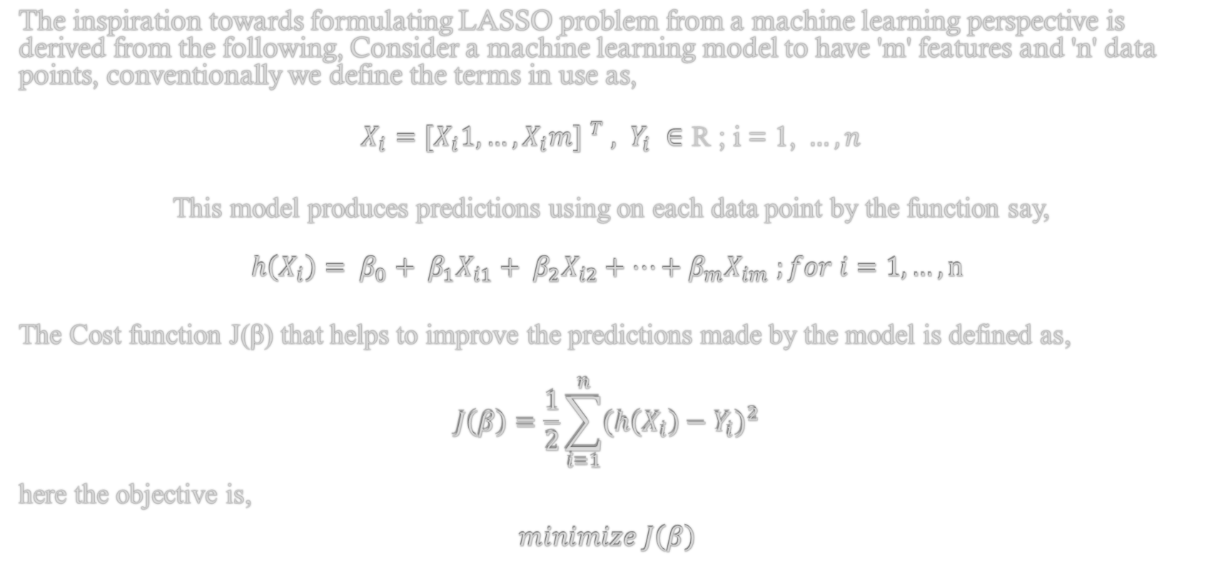
Arriving at the LASSO problem from a real-life requirement,
The inspiration towards formulating LASSO problem from a machine learning perspective is derived from the following, Consider a machine learning model to have 'm' features and 'n' data points, conventionally we define the terms in use as,
$X_{i}={{[X}_{i}1, …,X_{i}m] }^{T} , Y_{i} ∈\text{ℝ}\text{ ; }\text{i}\text{ = 1, }…, n$
This model produces predictions using on each data point by the function say,
$$h\left(X_{i}\right)= β_{0}+ β_{1}X_{i1}+ β_{2}X_{i2}+…+β_{m}X_{im} ;for i=1, …, n$$
The Cost function J(β) that helps to improve the predictions made by the model is defined as,
$$J\left(β\right)=\frac{1}{2}\sum_{i=1}^{n}{{(h\left(X_{i}\right)−Y_{i})}^{2}}$$
here the objective is,
$$minimize J\left(β\right)$$

Slide 50
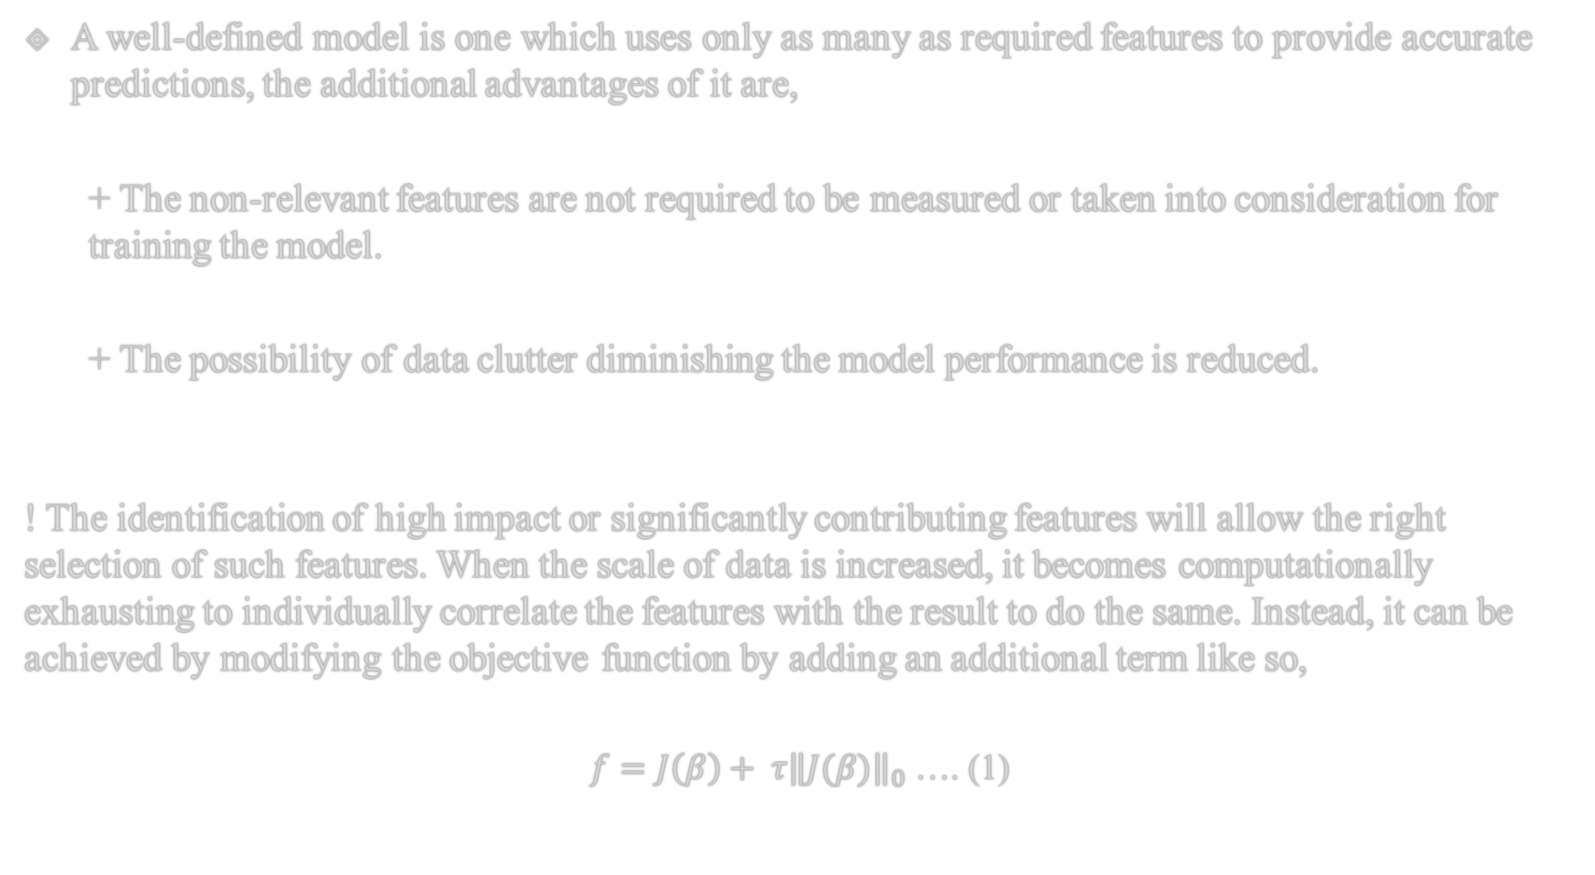
A well-defined model is one which uses only as many as required features to provide accurate predictions, the additional advantages of it are,
+ The non-relevant features are not required to be measured or taken into consideration for training the model.
+ The possibility of data clutter diminishing the model performance is reduced.
! The identification of high impact or significantly contributing features will allow the right selection of such features. When the scale of data is increased, it becomes computationally exhausting to individually correlate the features with the result to do the same. Instead, it can be achieved by modifying the objective function by adding an additional term like so,
$f=J\left(β\right)+ τ{\left\|J(β)\right\|}_{0}$ …. (1)

Slide 51
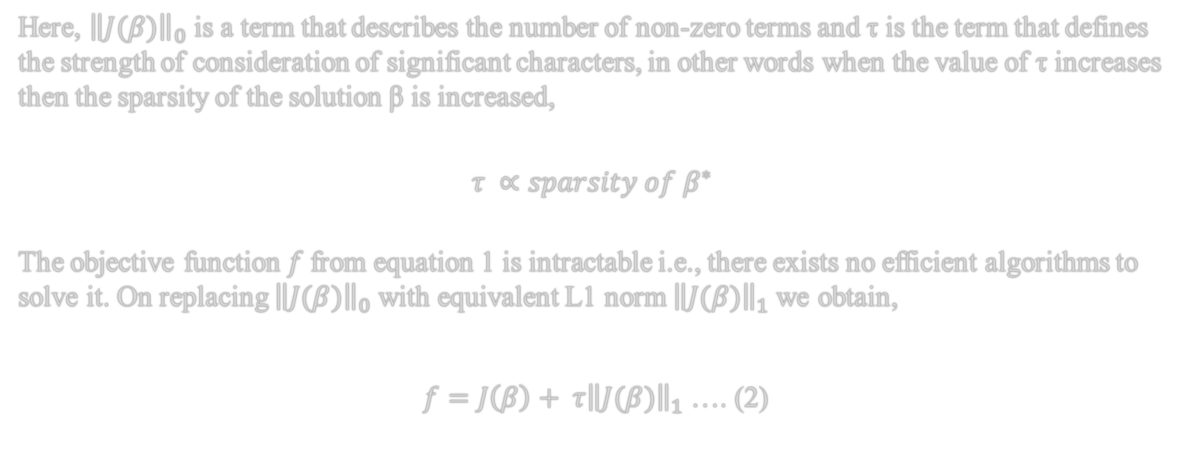
Here, ${\left\|J(β)\right\|}_{0}$ is a term that describes the number of non-zero terms and τ is the term that defines the strength of consideration of significant characters, in other words when the value of τ increases then the sparsity of the solution β is increased,
$$τ ∝sparsity of β^{∗}$$
The objective function $f$from equation 1 is intractable i.e., there exists no efficient algorithms to solve it. On replacing ${\left\|J(β)\right\|}_{0}$with equivalent L1 norm ${\left\|J(β)\right\|}_{1}$we obtain,
$f=J\left(β\right)+ τ{\left\|J(β)\right\|}_{1}$ …. (2)

Slide 52
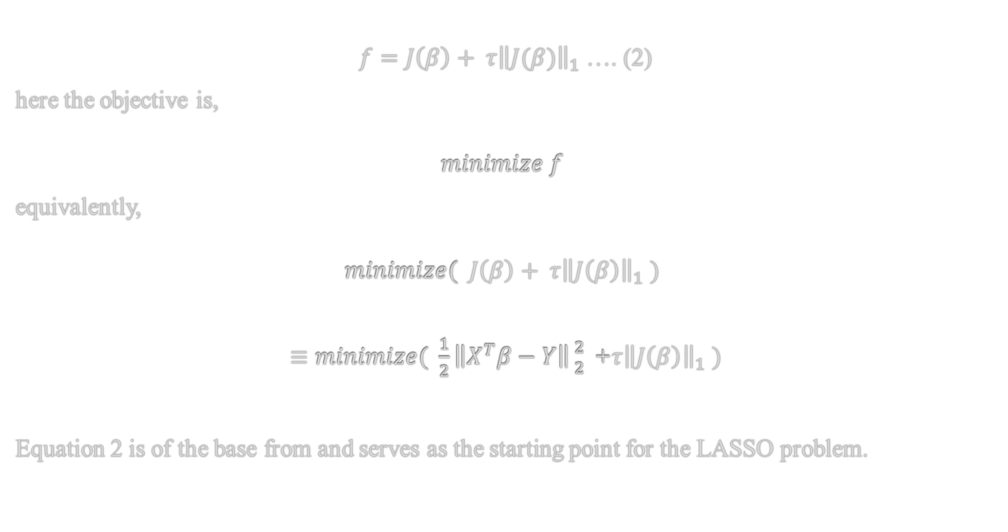
$f=J\left(β\right)+ τ{\left\|J(β)\right\|}_{1}$ …. (2)
here the objective is,
$$minimize f$$
equivalently,
$$minimize( J\left(β\right)+ τ{\left\|J\left(β\right)\right\|}_{1} )$$
$≡minimize( \frac{1}{2}\left\|X^{T}β−Y\right\|{2 \atop 2}\text{ +}τ{\left\|J\left(β\right)\right\|}_{1} )$
Equation 2 is of the base from and serves as the starting point for the LASSO problem.

Slide 53
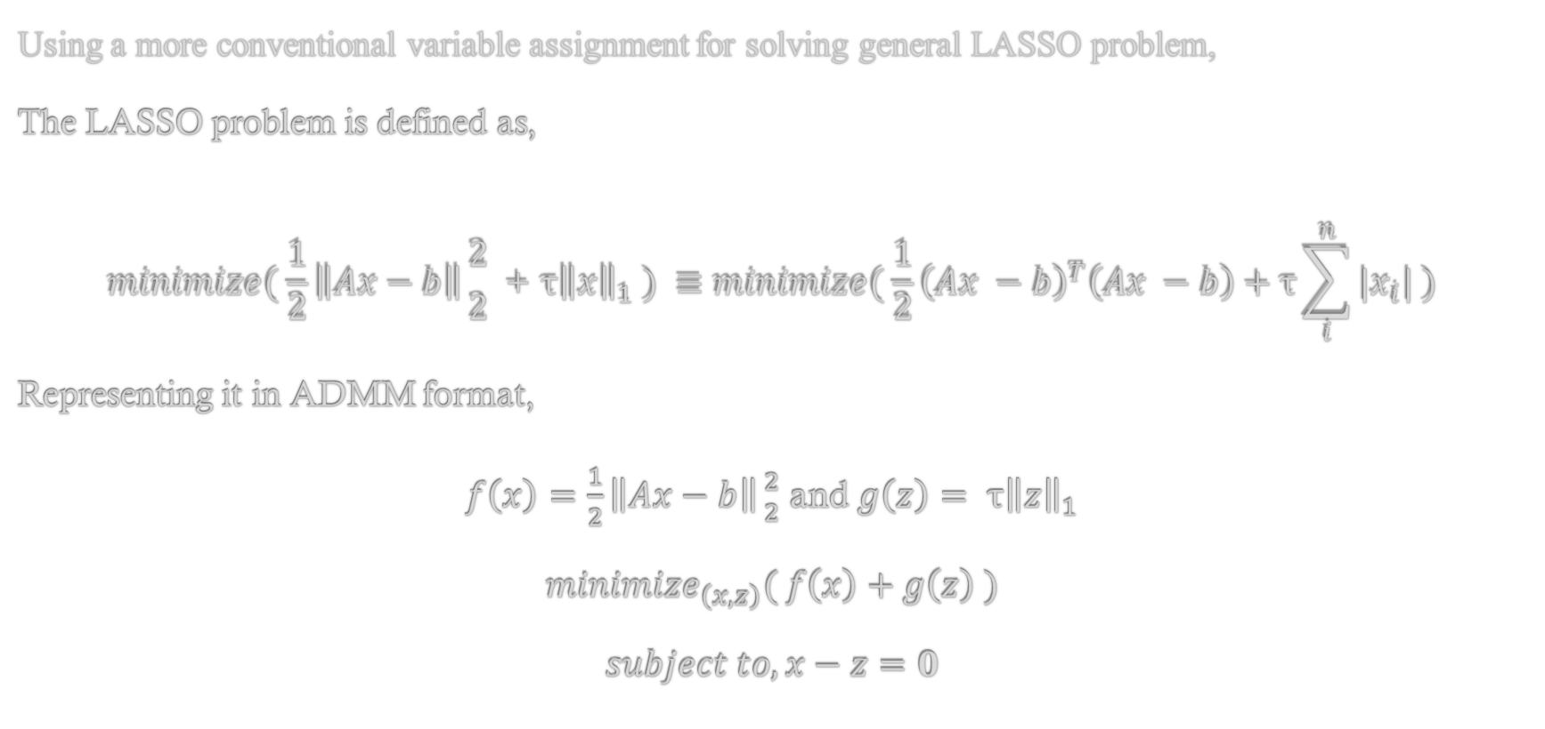
Lasso Problem
Using a more conventional variable assignment for solving general LASSO problem,
The LASSO problem is defined as,
$$minimize( \frac{1}{2}\left\|Ax−b\right\|{2 \atop 2} \text{+ }\text{τ}{\left\|x\right\|}_{1} ) ≡minimize( \frac{1}{2}{\left(Ax −b\right)}^{T}\left(Ax −b\right)\text{ + }\text{τ}\sum_{i}^{n}{{|x}_{i}|} )$$
Representing it in ADMM format,
$f\left(x\right)=\frac{1}{2}\left\|Ax−b\right\|{2 \atop 2}$ and $g\left(z\right)= \text{τ}{\left\|z\right\|}_{1}$
$${minimize}_{\left(x,z\right)}( f\left(x\right)+g\left(z\right) )$$
$$subject to, x−z=0$$

Slide 54
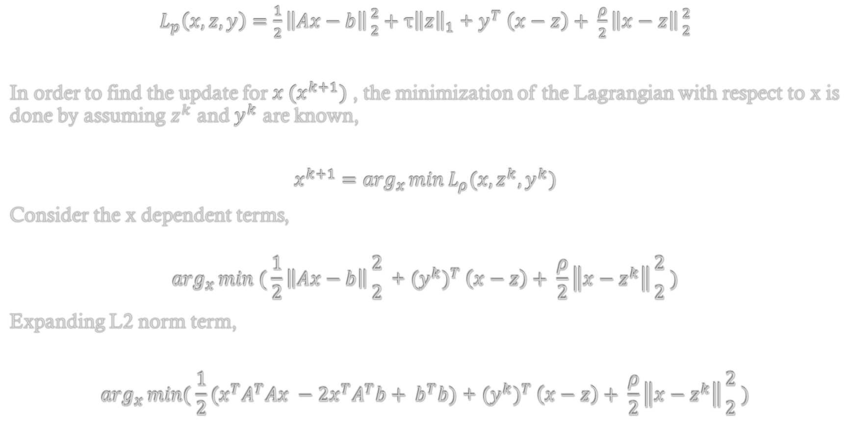
Solution,
$L_{p}\left(x, z, y\right)=\frac{1}{2}\left\|Ax−b\right\|{2 \atop 2}+\text{τ}{\left\|z\right\|}_{1}$ + $y^{T} \left(x−z\right)+ \frac{ρ}{2}\left\|x−z\right\|{2 \atop 2}$
In order to find the update for ${x (x}^{k+1})$ , the minimization of the Lagrangian with respect to x is done by assuming $z^{k}$ and $y^{k}$ are known,
$$x^{k+1}=\arg_{x}\min{L_{ρ}(x,z^{k},y^{k})}$$
Consider the x dependent terms,
$$\arg_{x}\min{( \frac{1}{2}\left\|Ax−b\right\|{2 \atop 2}\text{ + }({y^{k})}^{T} \left(x−z\right)+ \frac{ρ}{2}\left\|x−z^{k}\right\|{2 \atop 2} )}$$
Expanding L2 norm term,
$$\arg_{x}\min{( \frac{1}{2}(x^{T}A^{T}Ax −2x^{T}A^{T}b+ b^{T}b)\text{ + }({y^{k})}^{T} \left(x−z\right)+ \frac{ρ}{2}\left\|x−z^{k}\right\|{2 \atop 2} )}$$

Slide 55
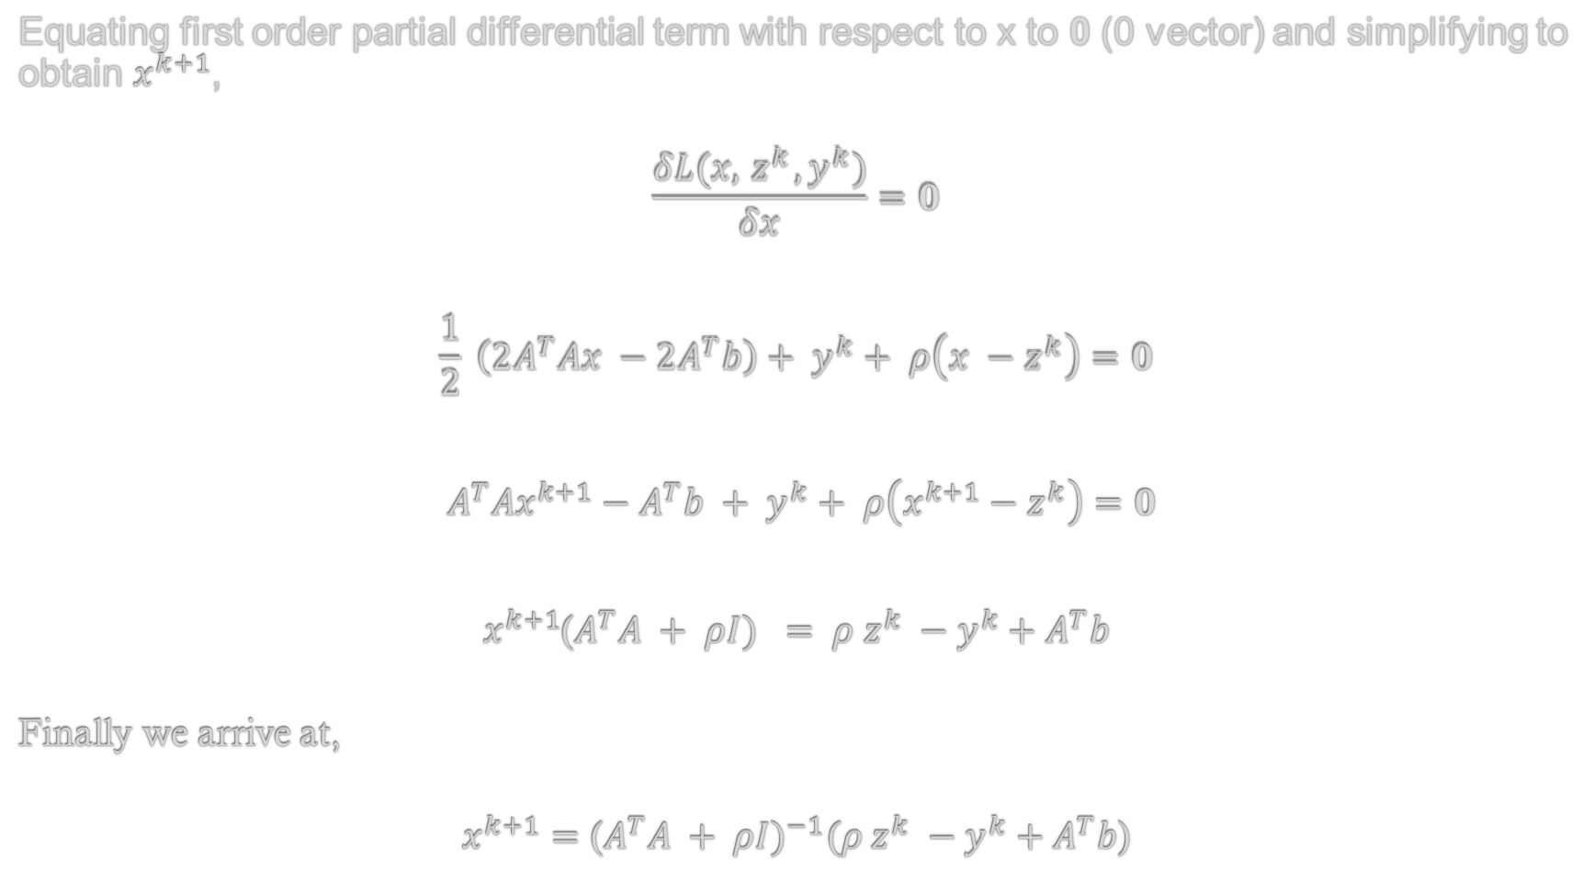
Equating first order partial differential term with respect to x to 0 (0 vector) and simplifying to obtain $x^{k+1}$,
$$\frac{δL(x,{ z}^{k},y^{k})}{δx}=0$$
$$\frac{1}{2} \left(2A^{T}Ax −2A^{T}b\right)+ y^{k}+ ρ\left(x −{ z}^{k}\right)=0$$
$A^{T}Ax^{k+1}−A^{T}b + y^{k}+ ρ\left(x^{k+1}−{ z}^{k}\right)=0$
$x^{k+1}$($A^{T}A + ρI) = ρ{ z}^{k} −y^{k}+A^{T}b$
Finally we arrive at,
$x^{k+1}={\text{(}A^{T}A + ρI)}^{−1}(ρ{ z}^{k} −y^{k}+A^{T}b$)

Slide 56
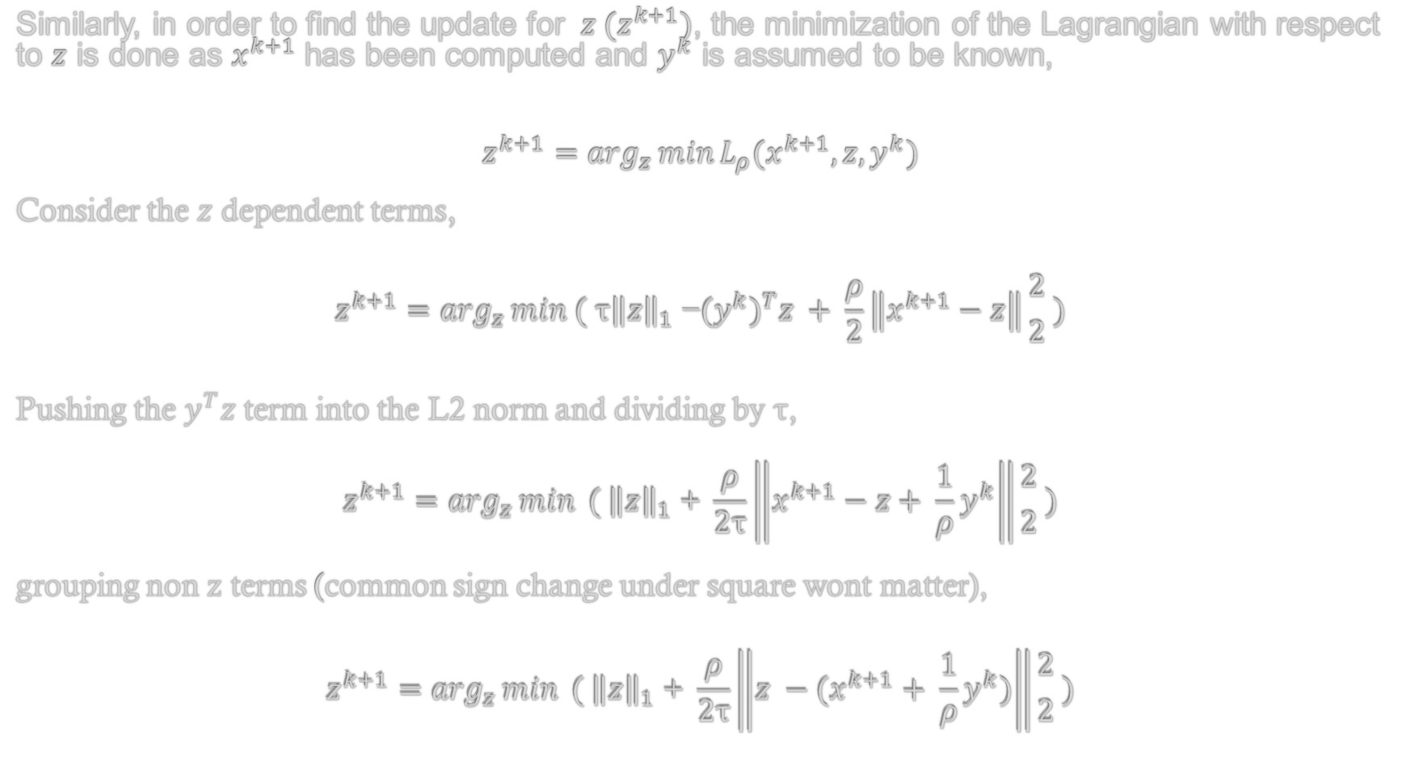
Similarly, in order to find the update for ${ z (z}^{k+1})$, the minimization of the Lagrangian with respect to $z$ is done as $x^{k+1}$has been computed and $y^{k}$ is assumed to be known,
$$z^{k+1}=\arg_{z}\min{L_{ρ}(x^{k+1},z,y^{k})}$$
Consider the $z$ dependent terms,
$$z^{k+1}=\arg_{z}\min{( {\text{τ}\left\|z\right\|}_{1} \text{−}({y^{k})}^{T}z + \frac{ρ}{2}\left\|x^{k+1}−z\right\|{2 \atop 2} )}$$
Pushing the $y^{T}z$ term into the L2 norm and dividing by τ,
$$z^{k+1}=\arg_{z}\min{{ ( \left\|z\right\|}_{1}\text{ + }\frac{ρ}{2\text{τ}}\left\|x^{k+1}−z+ \frac{1}{ρ}y^{k}\right\|{2 \atop 2}} )$$
grouping non z terms (common sign change under square wont matter),
$$z^{k+1}=\arg_{z}\min{{ ( \left\|z\right\|}_{1}\text{ + }\frac{ρ}{2\text{τ}}\left\|z −(x^{k+1}+ \frac{1}{ρ}y^{k})\right\|{2 \atop 2} )}$$

Slide 57
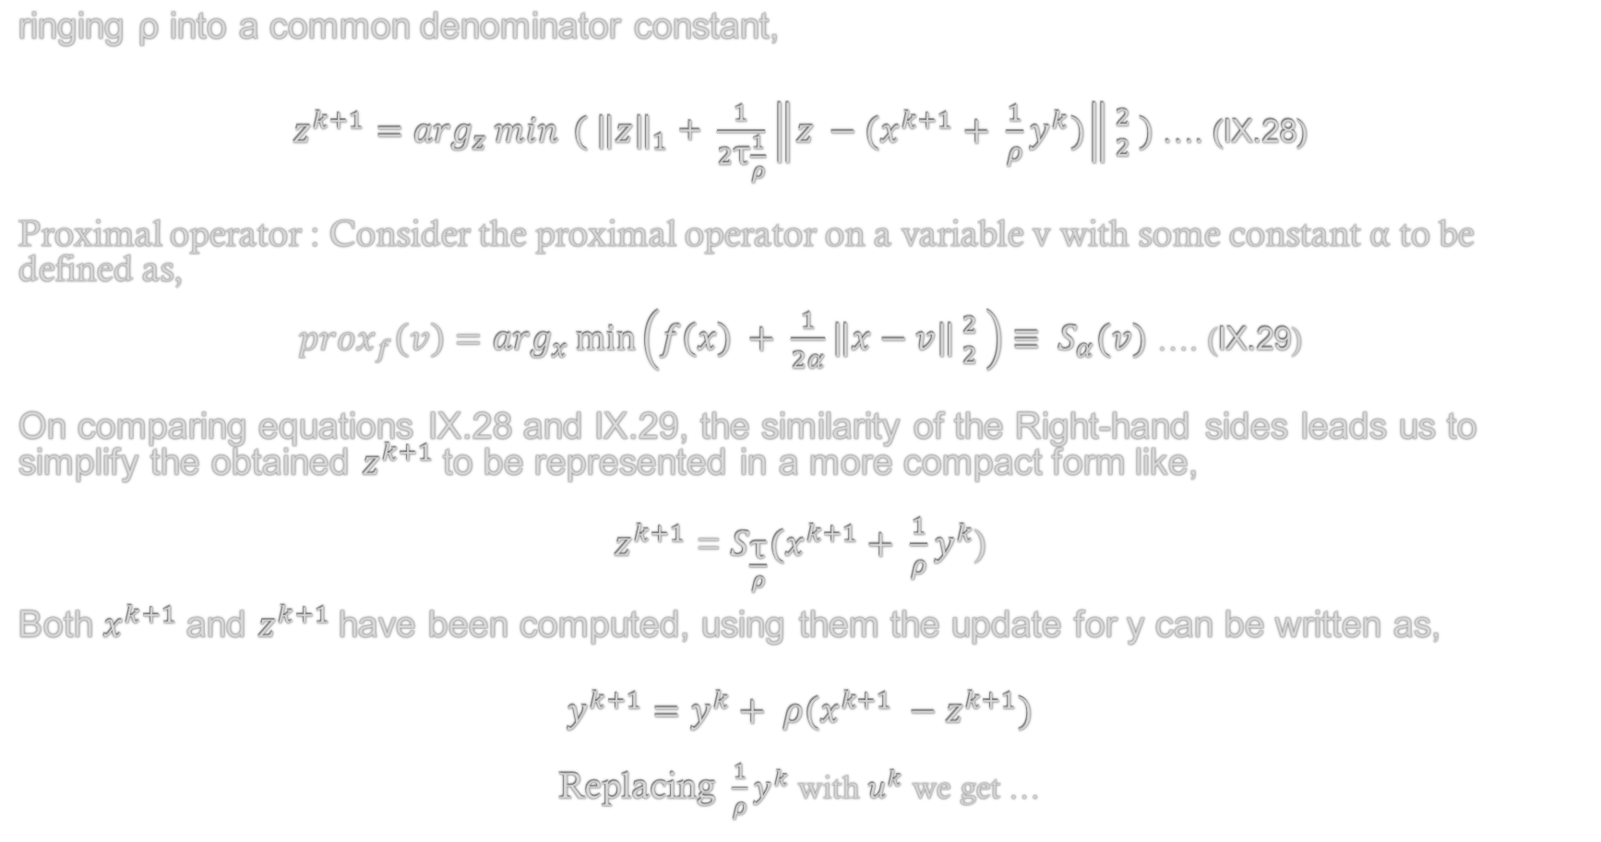
ringing ρ into a common denominator constant,
$z^{k+1}=\arg_{z}\min{{ ( \left\|z\right\|}_{1}\text{ + }\frac{1}{2\text{τ}\frac{1}{ρ}}\left\|z −(x^{k+1}+ \frac{1}{ρ}y^{k})\right\|{2 \atop 2} )}$ …. (IX.28)
Proximal operator : Consider the proximal operator on a variable v with some constant α to be defined as,
${prox}_{f}\left(v\right)=\arg_{x}\min\left(f\left(x\right) + \frac{1}{2α}\left\|x−v\right\|{2 \atop 2} \right)≡ S_{α}(v)$ …. (IX.29)
On comparing equations IX.28 and IX.29, the similarity of the Right-hand sides leads us to simplify the obtained $z^{k+1}$to be represented in a more compact form like,
$z^{k+1}$ = $S_{\frac{\text{τ}}{ρ}}(x^{k+1}+ \frac{1}{ρ}y^{k}$)
Both $x^{k+1}$and $z^{k+1}$have been computed, using them the update for y can be written as,
$$y^{k+1}=y^{k}+ ρ(x^{k+1} −z^{k+1})$$
Replacing ${\frac{1}{ρ}y}^{k}$ with $u^{k}$ we get …

Slide 58
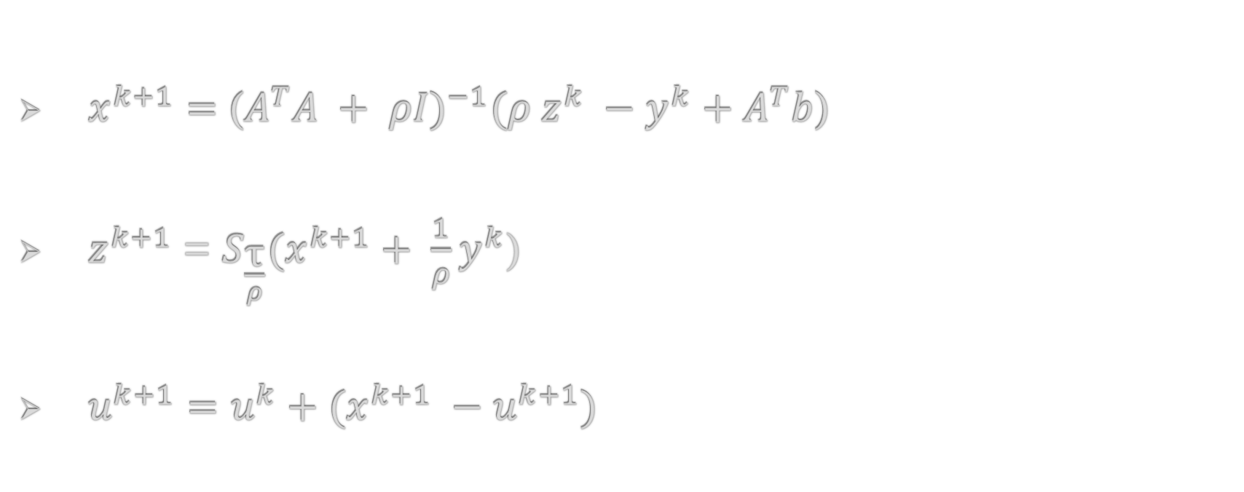
Final update equations,
$x^{k+1}={\text{(}A^{T}A + ρI)}^{−1}(ρ{ z}^{k} −y^{k}+A^{T}b$)
$z^{k+1}$ = $S_{\frac{\text{τ}}{ρ}}(x^{k+1}+ \frac{1}{ρ}y^{k}$)
$u^{k+1}=u^{k}+(x^{k+1} −u^{k+1})$

Slide 59






LAD
Huber
LASSO
Formulation,
Formulation,
Formulation,
$$\min_{x,z}{\sum_{i=1}^{m}{huber(z_{i})}}$$
$$s.t Ax−z=b$$
$f\left(x\right)=\frac{1}{2}\left\|Ax−b\right\|{2 \atop 2}$ and $g\left(z\right)= \text{τ}{\left\|z\right\|}_{1}$
$${minimize}_{(x,z)} f\left(x\right)+g(z)$$
$$s.t x−z=0$$
$$\min{ }{\left\|z\right\|}_{1}$$
$$\text{s}\text{.}\text{t} Ax−b=z$$
Update equations,
Update equations,
Update equations,
$$x^{k+1} ≔{\left(A^{T}A\right)}^{−1}A^{T}\left(b+z^{k}−u^{k}\right)$$
$$z^{k+1}=S_{\left(1/ρ\right)}\left(Ax^{k+1}−b+u^{k}\right)$$
$$u^{k+1}=u^{k}+(Ax^{k+1}−b−z^{k+1})$$
$x^{k+1}={\left(A^{T}A\right)}^{−1}A^{T}\left(b+z^{k}−u^{k}\right)$
$z^{k+1}=\frac{1}{1+λ}\left(Ax^{k+1}−b+u^{k}\right)+\frac{λ}{1+λ}S_{λ}(Ax^{k+1}−b+u^{k})$
$u^{k+1}=u^{k}+(x^{k+1} −u^{k+1})$
$x^{k+1}={\text{(}A^{T}A + ρI)}^{−1}(ρ{ z}^{k} −y^{k}+A^{T}b$)
$z^{k+1}$ = $S_{\frac{\text{τ}}{ρ}}(x^{k+1}+ \frac{1}{ρ}y^{k}$)
$u^{k+1}=u^{k}+(x^{k+1} −u^{k+1})$

Slide 60
Matlab Code for LAD, Huber and LASSO update iterations

Slide 61
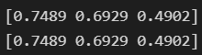
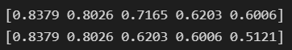
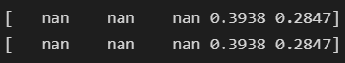
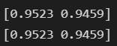
Python Results for 4 datasets
Datasets trialed - https://scikit-learn.org/stable/datasets/toy_dataset.html
Comparison between the Highest Correlation Coefficient values in features vs result and the Correlation Coefficient values of the features retained(decided by LASSO) and the result,
Boston Dataset
Wine Dataset
Digits Dataset
Iris Dataset

Slide 62
Thank You

